Slide 1
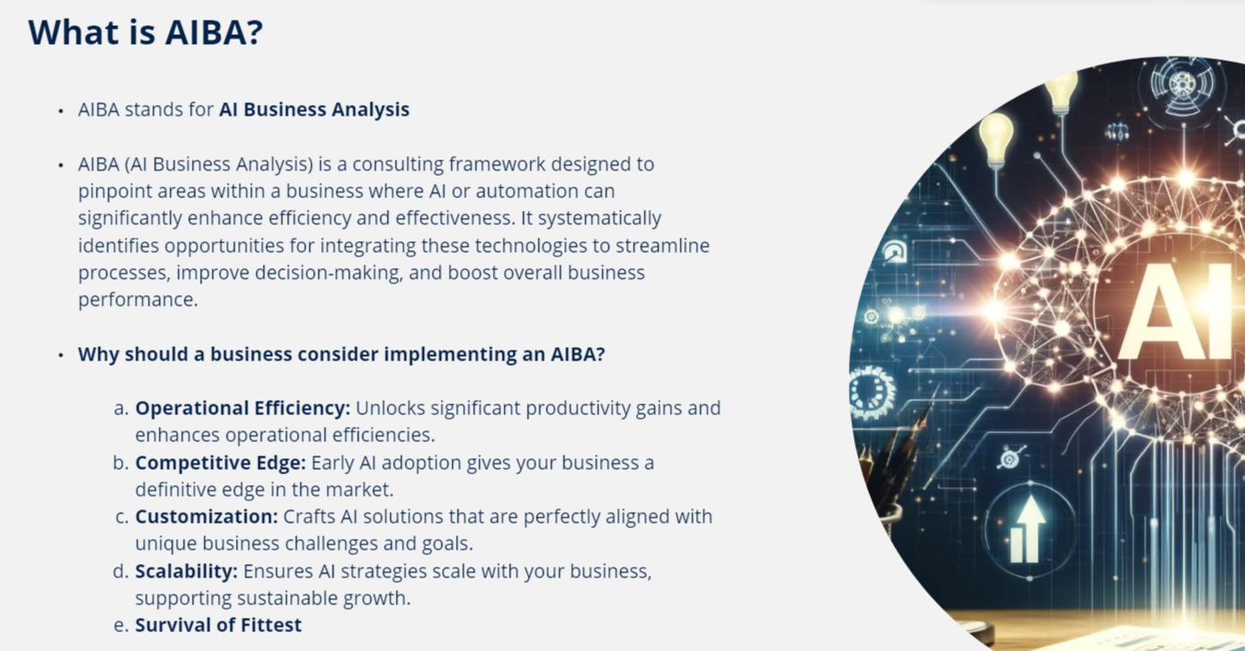


Slide 2
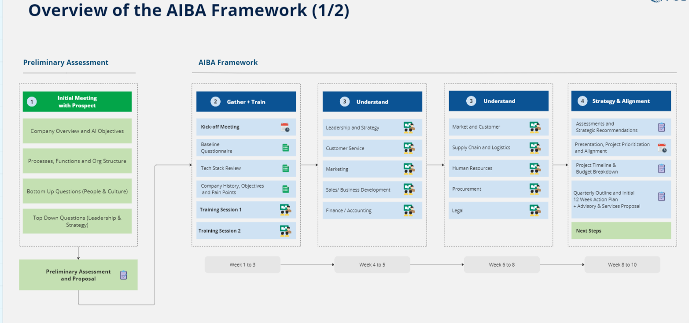

Slide 3
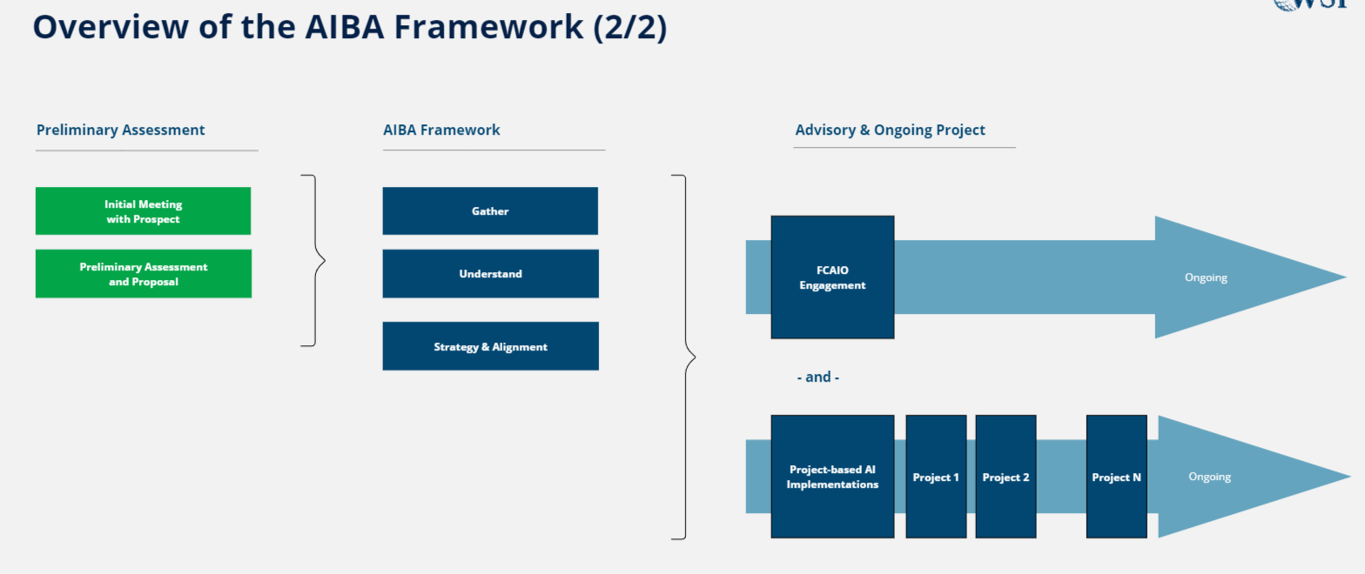

Slide 4
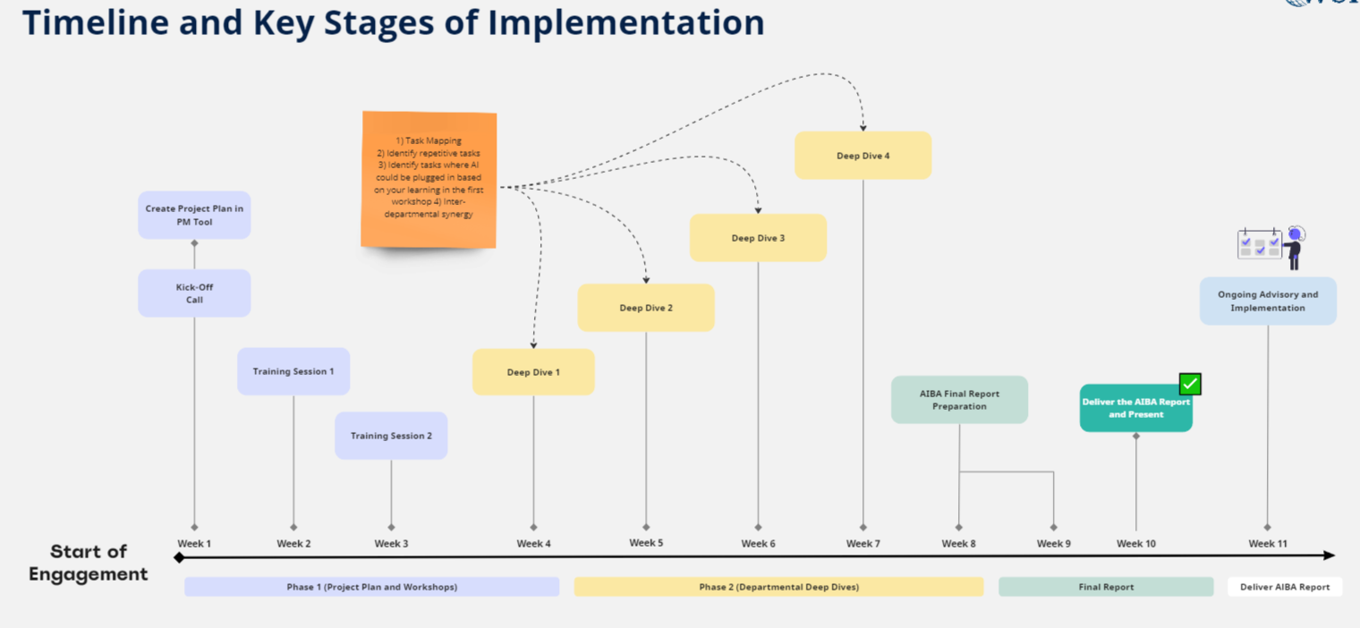

Slide 5
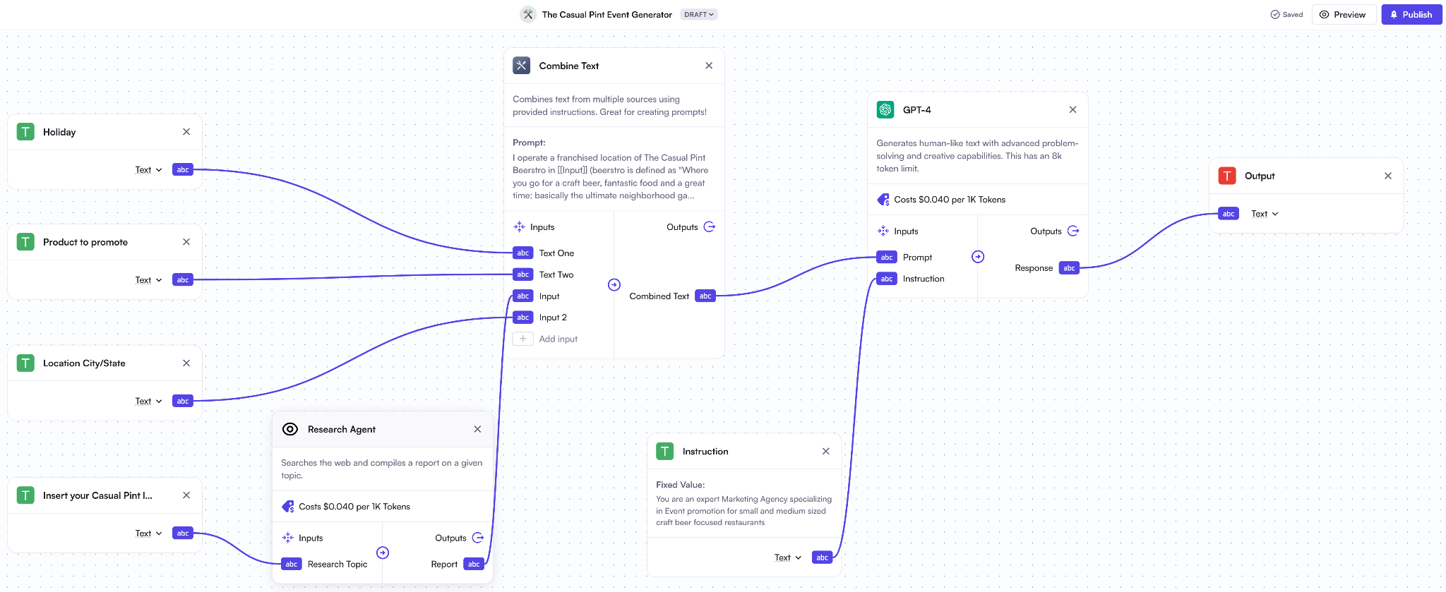

Slide 6
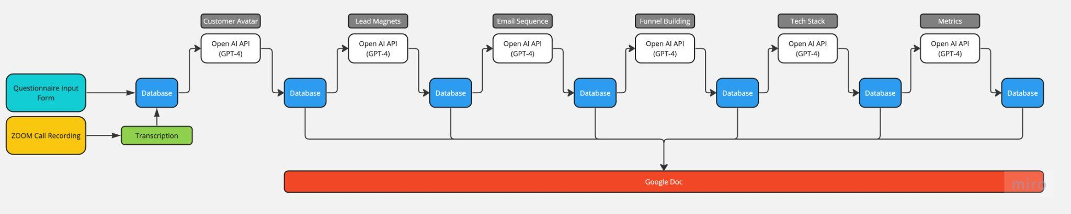
Case Study:
Lead Generation
Business owners are often tasked with developing executing a Lead Generation Strategy. This API Tool leverages sophisticated data handling in order to automate a complex and repetitive task.

